Slide 1


2023 BJA Request Legislation
Brittany Gregory, JD – Associate Director of Judicial and Legislative Relations, AOC
December 12, 2022

Slide 2
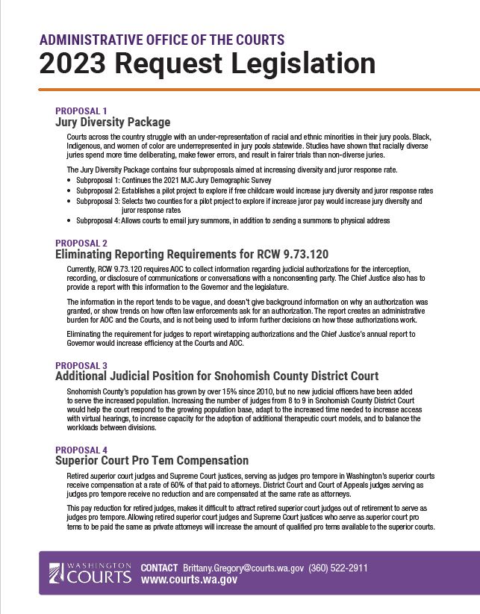
2023 BJA Legislative Slate
AOC request legislation is proposed on behalf of the Board for Judicial Administration
4 proposals centered on Judicial Branch efficiency & increasing equity and access!

Slide 3
Proposal #1: Jury Diversity Package
Washington Courts 2021 Gender Justice Study: How Gender and Race Affect Justice Now
Subproposal 1: Continues the 2021 MJC Jury Demographic Survey
Subproposal 2: Establishes a pilot project to explore if free childcare would increase jury diversity and juror response rates
Subproposal 3: Increases juror pay for potential jurors who qualify for means tested, state-funded benefit programs Subproposal 4: Allows courts to email jury summons, in addition to sending a summons to physical address
Courts across the country struggle with an under-representation of racial and ethnic minorities in their jury pools. Black, Indigenous, and women of color are underrepresented in jury pools statewide.
GOAL: Increase data collection on the demographics of Washington juries and eliminate barriers affecting juror participation

Slide 4
Jury Diversity Package- Subproposal #1
Subproposal #1: Continues the 2021 MJC Jury Demographic Survey
  The survey collects data on a juror's race, ethnicity, age, sex, employment status, educational attainment and income, and is currently funded until the end of FY23.
  The data collected by the survey will help the courts better understand why marginalized groups experience more obstacles to participating on juries, and should be continued as a statewide mandate, as monitoring jury demographics is the only way for the courts to ensure that juror pools are representative of their communities.
Notes:
The MJC Jury Demographic Survey was funded through a budget proviso in 2021. There hasn’t been a mechanism like this to collect accurate statewide data on WA juries.
Best way for the court to figure out what barriers exist, and to know if any new measure is making a difference.

Slide 5

Jury Diversity Package- Subproposal #2
In 2019, the Minority and Justice Jury Diversity Task Force identified adequate childcare as a high priority to potential jurors. Providing childcare could alleviate economic burdens and barriers to juror participation, particularly for minority and low-income populations. We would like to explore how childcare affects juror participation and jury diversity.
Subproposal #2: Establishes a pilot project to explore if free childcare would increase jury diversity and juror response rates

Slide 6
Jury Diversity Package- Subproposal #3
Subproposal #3: Increases juror pay for potential jurors who qualify for means tested, state-funded benefits programs to $125/day.
Increasing juror pay has been a Judicial Branch priority for 20 years!
Restriction: Limited to individuals who’s employer’s don’t pay for performing jury service & qualify through means-tested, state-funded benefits programs.

Slide 7
Jury Diversity Package- Subproposal #4
Subproposal #4: Allows courts to email jury summons, in addition to sending a summons to physical address
  The Department of Licensing (DOL) and Secretary of State (SOS) provide data to WaTech, who then merges the data and creates a potential duplicates list. This list is then passed along to the courts by AOC, so that courts can build their jury source list.
  Currently, in Washington, all summons must be sent via US mail or personal service under RCW 2.36.095
  This proposal would call for DOL and SOS to share email addresses with AOC, so courts would have the option of emailing jury summons, in addition to mail/personal service.

Slide 8
Proposal #2: Eliminating Wiretapping Authorization Reporting
GOAL: Eliminate reporting requirement in 9.73.120 to increase efficiency
Currently, RCW 9.73.120 requires AOC to collect information regarding judicial authorizations for the interception, recording, or disclosure of communications or conversations with a nonconsenting party.
Section (1)(a-h)
Section 2
  The Chief Justice also has to provide a report with this information to the Governor and the legislature.
Section 2
9.73.120 data collection and report are an administrative burden for AOC and the courts—not being used to inform further decisions on how these authorizations work.

Slide 9

Proposal #3: Additional Judicial Position for Snohomish County District Court
GOAL: Increase # of judges in Snohomish County District Court from 8 to 9.
The Snohomish County District Court currently has eight judges and one commissioner.
Snohomish County District Court needs to increase the number of judges to nine in order to respond to the growing population base
The most recent Judicial Needs Estimate recommends 9.56 judicial officers are needed.
No fiscal impact to the State—County Council has agreed to fund position!

Slide 10
Proposal #4: Superior Court Pro Tem Compensation
Retired superior court judges and Supreme Court Justices, serving as judges pro tempore in Washington’s Superior Courts receive compensation at a rate of 60% of that paid to attorneys.
Current Pro Tem Rate: $116/hr
GOAL: Pay equity between private attorneys and retired superior court judges and Supreme Court Justices who serve as pro tems in superior court.
District Court judges serving as judges pro tempore receive no reduction and are compensated at the same rate as attorneys.

Slide 11
Policy/Fiscal Proposal- Lactation Pods in Superior Courts
Mother Attorneys Mentoring Association (MAMA) and AOC have drafted best practices for court lactation spaces
While motherhood has been considered a barrier to women entering the legal field, dedicated lactation rooms in courthouses will help to remove that barrier.
Lactation spaces promote the health of the mother and baby through continued nursing.
16 County Jurisdictions indicated interest/need for lactation accommodation space.
  11 of which do not currently have any lactation accommodations available.
Representative Berry working with AOC to request funding for lactation pods for superior courts that need a lactation space.

Slide 12
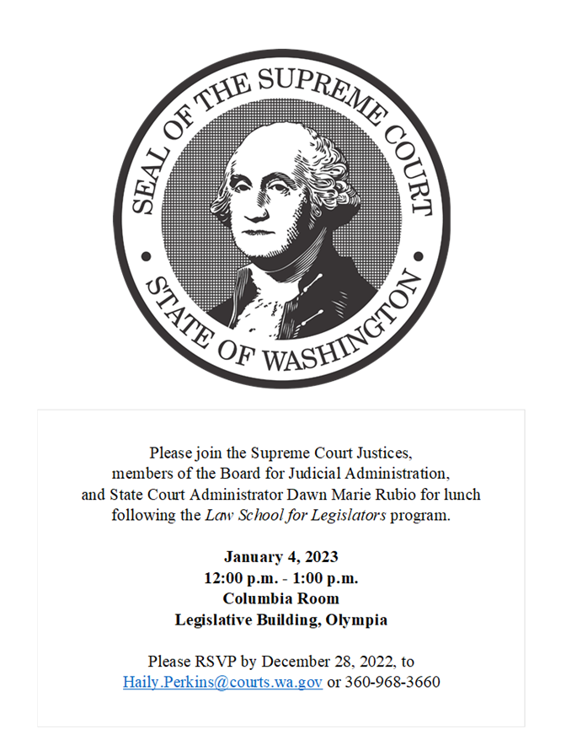
Law School for Legislators Luncheon

Slide 13
2023 State of Judiciary Address & Legislative Reception
If SCR 8400 passes, there will be a legislative reception following the 2023 State of Judiciary Address
Reception will be held on Capitol Campus in the Columbia Room of the Legislative Building
More details to come

Slide 14
Questions?
Brittany Gregory
Cell: 360-522-2911
Brittany.Gregory@courts.wa.gov
Haily Perkins
Haily.Perkins@courts.wa.gov

